Slide 1

Navigating the Diamond Cluster
Felicity Bertram
MX Support Scientist
mx-usersupport@diamond.ac.uk
Felicity.Bertram@diamond.ac.uk

Slide 2



Background
Before Covid:
50% of Diamond Users are MX
55% of Experimental Sessions are MX
More than 75% of MX visits were remote

Slide 3
Since then added UDC to our offering
UDC is “Unattended Data Collection” which doesn’t need any User interaction once they have put their data collection parameters into ISPyB, before shipping their crystals
But now we don’t have Users on site, it’s harder to interact with them and train them – hence doing courses like this.
Therefore please take the opportunity to network with members of the Diamond team

Slide 4
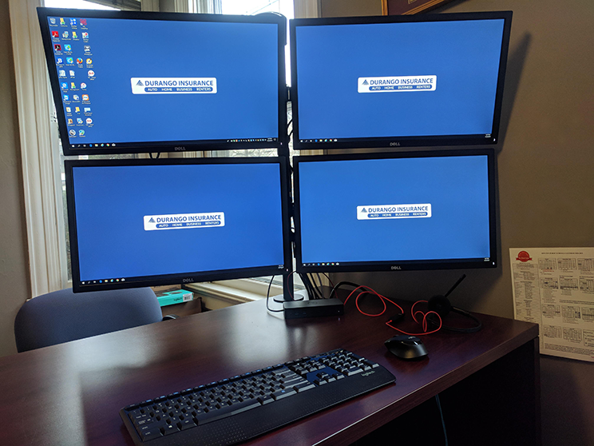
Lots of monitors to control a beamline…

Slide 5
Last Year’s Audience

Slide 6

Multiple ways to get to the same destination...

Slide 7

You have to be precise

Slide 8
Fed IDs and Passwords
You all have a Fed ID and password.
If needed, Diamond staff can tell you what your Fed ID is, but not what your password is
We can only request that a password is reset – and that is within UK office hours
You will use this to log in to NX sessions (this talk) and ISPyB sessions (the next talk with Marco Mazzorana) – so make sure it works

Slide 9

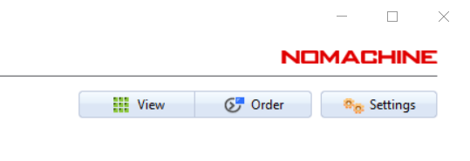
NoMachine – Enterprise Client
→ your route in to Diamond
Download to your machine - https://www.nomachine.com/product&p=NoMachine%20Enterprise%20Client
OR
Make sure it is the latest version in Settings

Slide 10
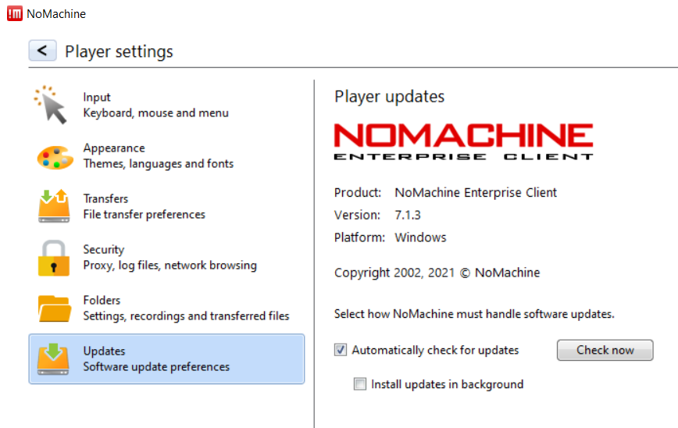
Checking for updates in settings

Slide 11
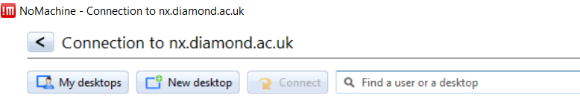
First Time Users/Computers
Create a new connection using the protocol NX
Set hostname to nx.diamond.ac.uk (ensure port is set to 4000)
Use password authentication
Don’t use a proxy
Give a name to the new connection, e.g. "Connection to nx.diamond.ac.uk"

Slide 12
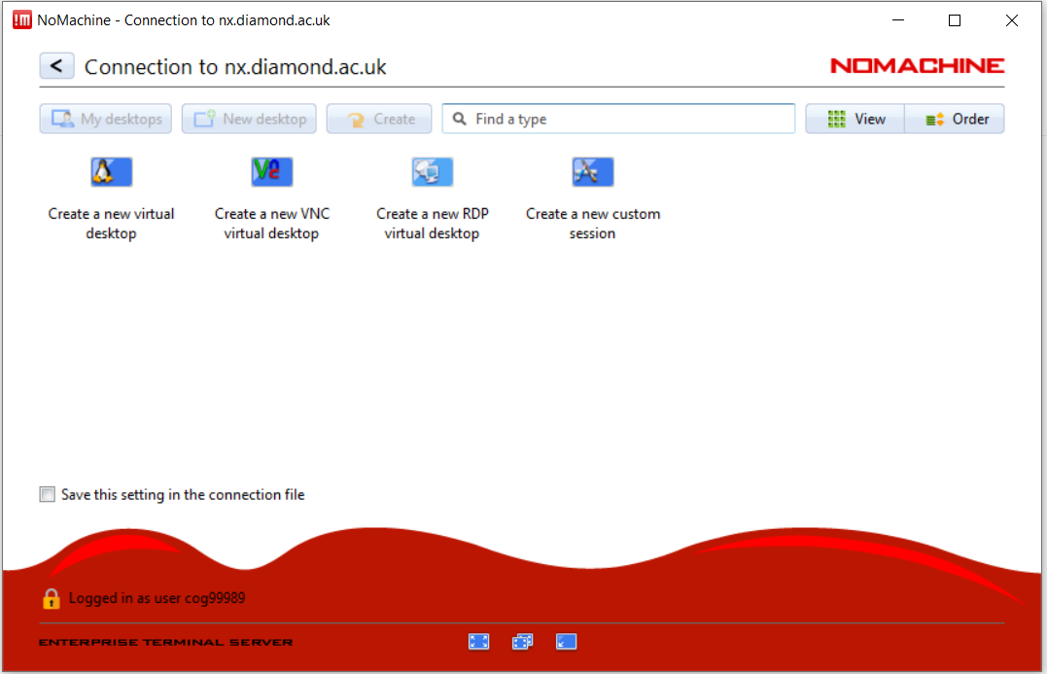

Create New Virtual Desktop

Slide 13
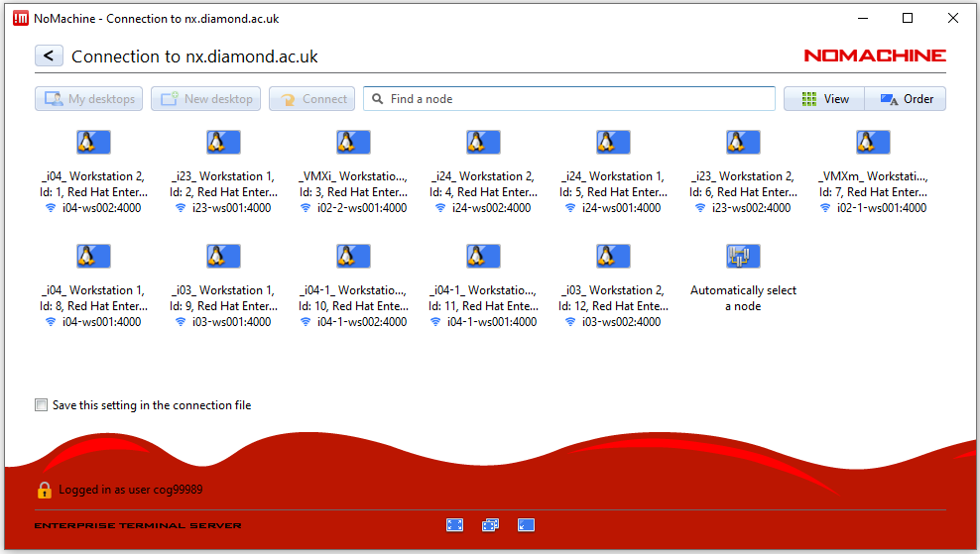
Connecting to NoMachine

Slide 14
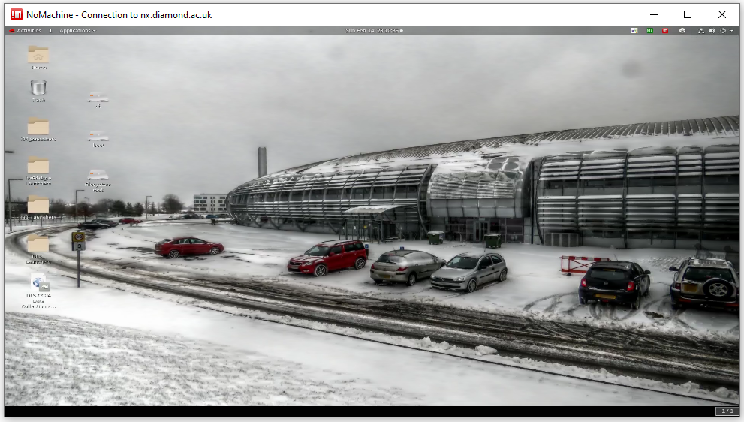
Connecting to a Beamline – only for a visit

Slide 15
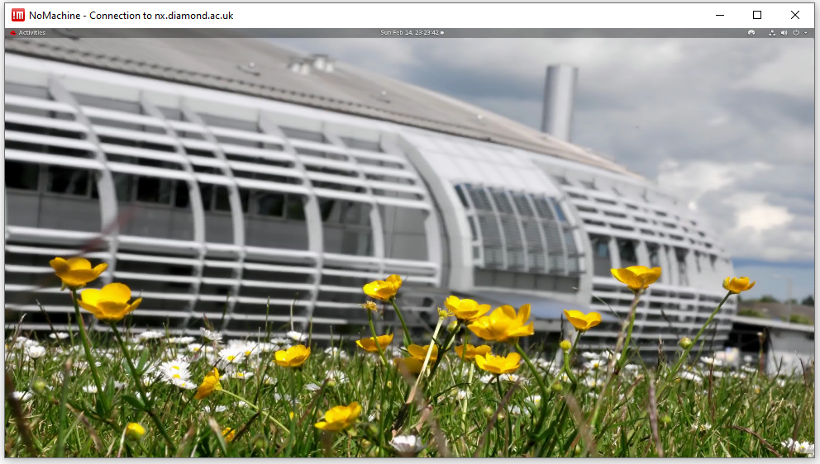
Automatically select a node – all data processing

Slide 16
Beamline Navigation & Tools

Slide 17
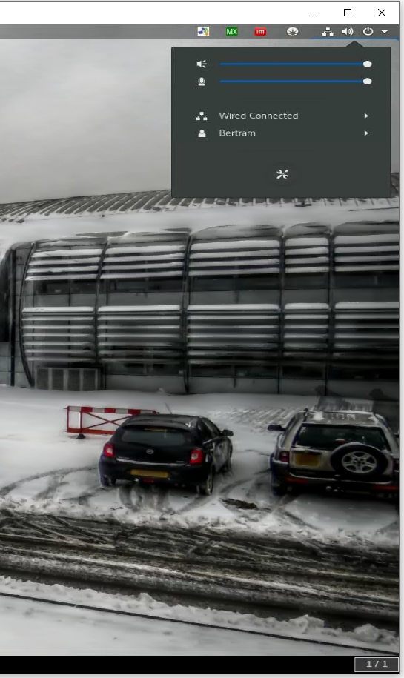
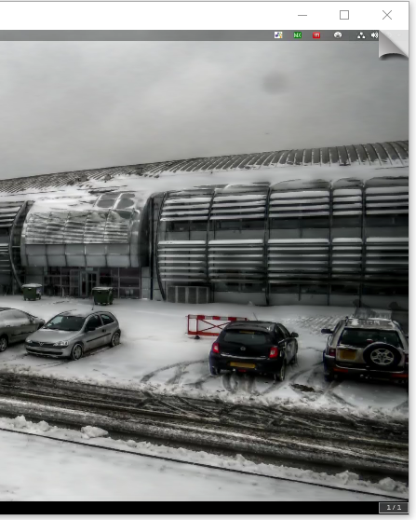
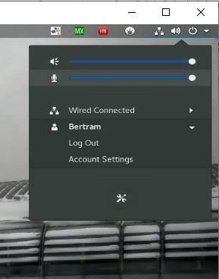
Logging Off
Log off:
power button
then click your name
Then click “Log Out”
NX Settings – “corner peel”

Slide 18
Account Settings

Slide 19
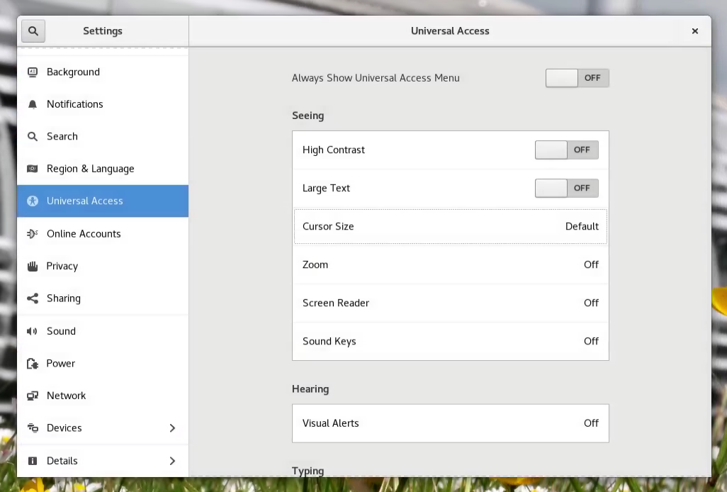
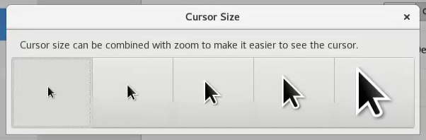
Universal Access
- use to increase the size of the cursor

Slide 20
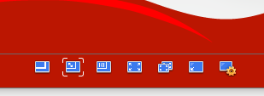
Nomachine Display Options
“Enable viewport display” = Scrolling window (annoying)
“Scale to window” = Fits in window, everything shrinks when window shrinks
“Resize remote display” = Fits in window, icons remain large if window shrinks
“Fullscreen” = window is maximised on current monitor
“Fullscreen on all monitors” = windows are maximised on all monitors
“Iconise” = minimise (ctrl + alt + M also works)
“Settings”

Slide 21
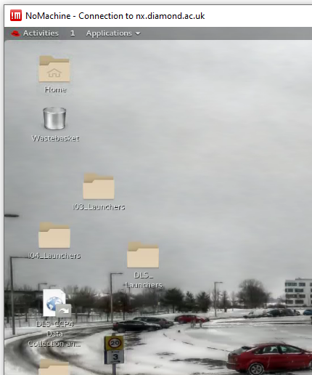
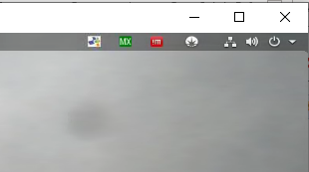
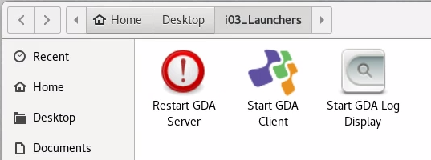

Launch GDA (Generic Data Acquisition)
- used to control beamlines and collect data

Slide 22
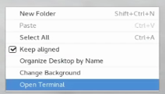
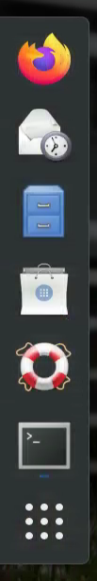
Launch GDA from a terminal
Start a terminal:
Activities → Terminal
Right-click → Open Terminal
In a terminal:
gdaclient – start GDA client
gdalog – start GDA log display
Gdaservers – restart GDA servers

Slide 23
This Course - Identifiers
All visits at Diamond happen under a Proposal – the Proposal for this course is mx33300
For the purposes of teaching, we have already had a visit on this proposal for you to find some exemplar data – mx33300-1
There will be additional visits for this course, such as for each of the beamline days (one for I03, one for I04 and one for I04-1), and to give you access to the tutorials etc., which will be numbered -2, -3, -4…

Slide 24
This Course - Identifiers
MX30951-1 – today’s visit for you to practice in & check access (I04)
was on 9th Sept to put some example data in for you to practice access
MX30951-2 – long visit (29th Nov – 10th Dec) to cover the whole course, with “data access only” for the participants to ensure access
MX30951-3 – 2nd Dec = beamline day on I03
MX30951-4 – 2nd Dec = beamline day on I04
MX30951-5 – 2nd Dec = beamline day on I04-1
MX30951-6 – 2nd Dec = beamline day on I23
MX30951-7 – 2nd Dec = beamline day on I24
MX30951-8 – already passed with sample data in

Slide 25
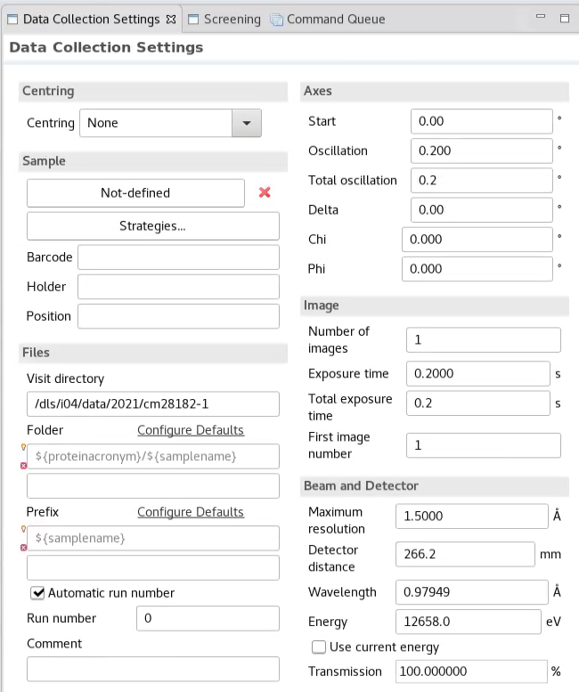
Data Collection Setup in GDA
By default, data is stored in folders
representing visits, with this structure:
/dls/{beamline}/data/{year}/{visit number}
  E.g. /dls/i03/data/2021/MX28204-5
Then within that the default is:
  /{proteinacronym}/{samplename}_{run_no}_
  {image_no}.cbf
For large visits with multiple Users, or if you
have multiple proteins, you can add YourName/
to the left of the folder field
  E.g. /dls/i03/data/2021/MX28204-5/Felicity/MyProtein/ProteinWT_1_3600.cbf

Slide 26
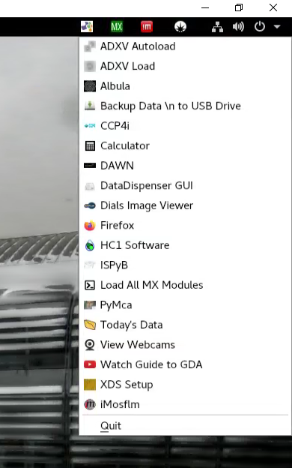
Image Viewers
Right-click

Slide 27
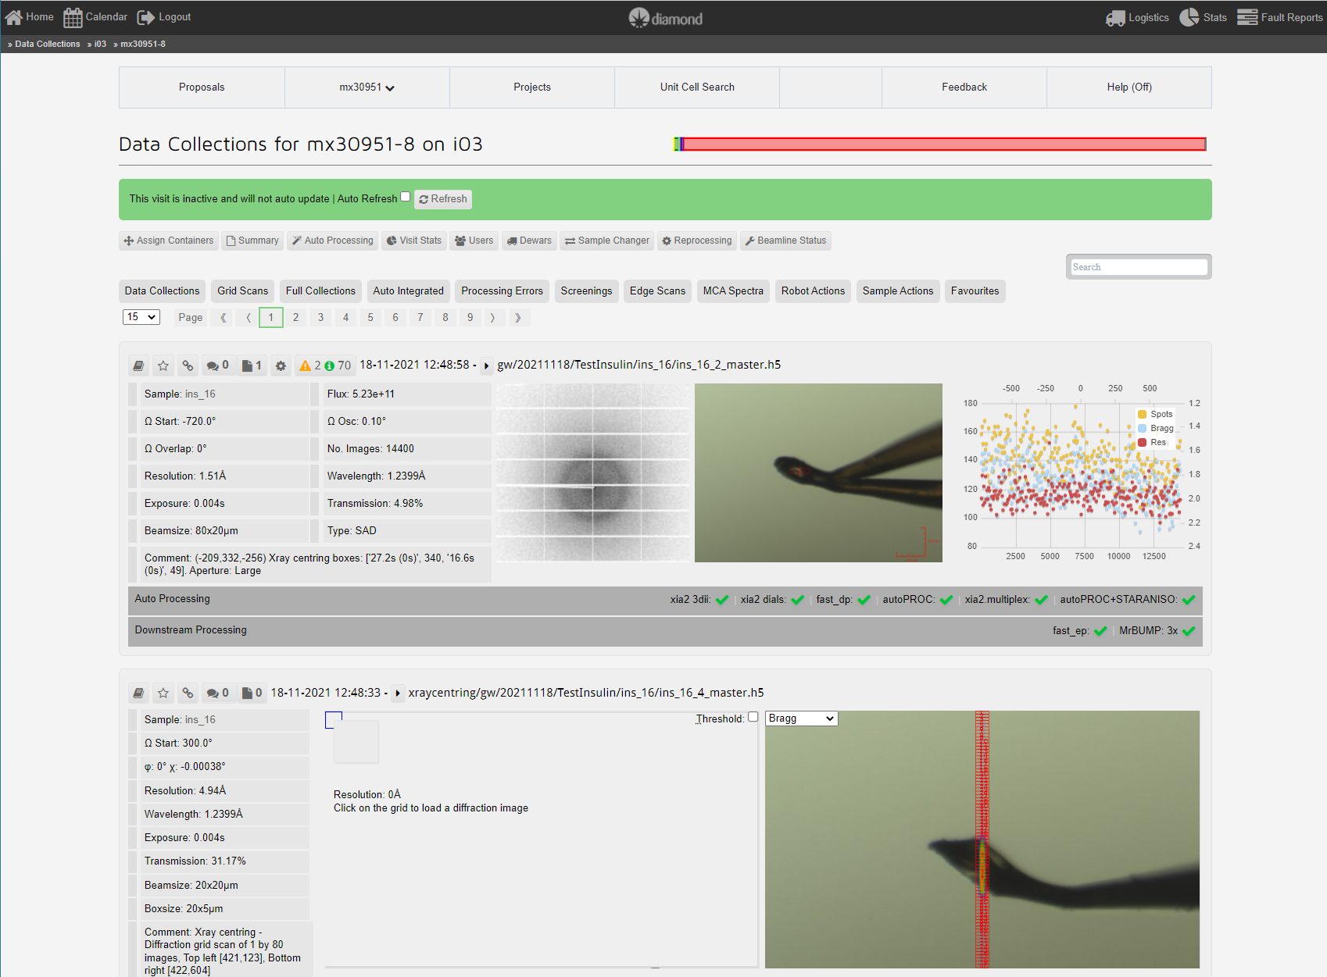
ISPyB View

Slide 28
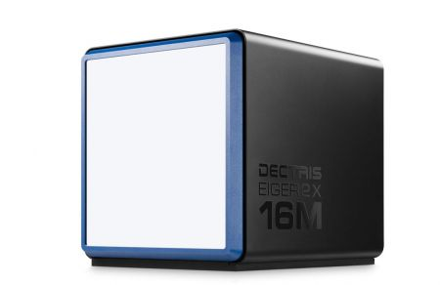
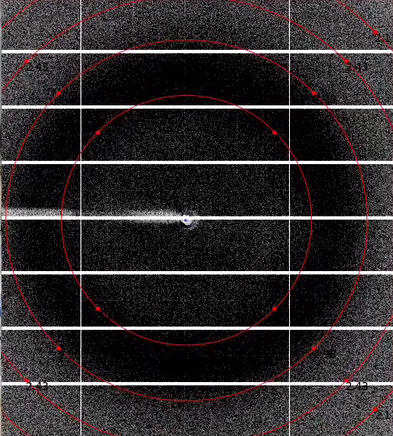
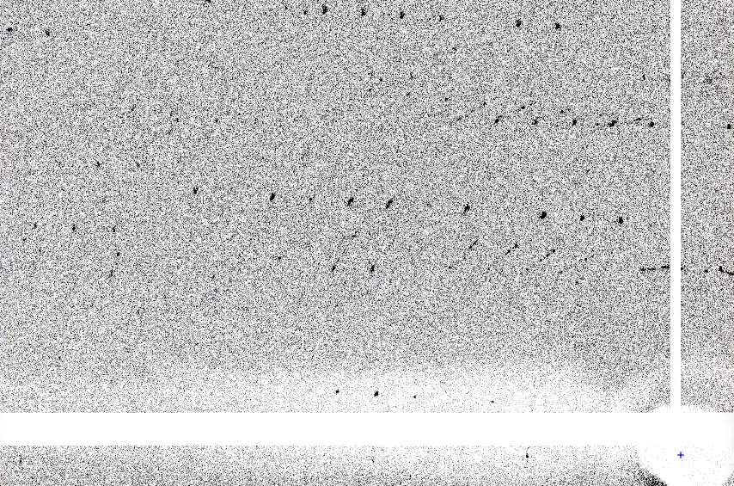
Dials Image Viewer or ADXV
Not ISPyB

Slide 29
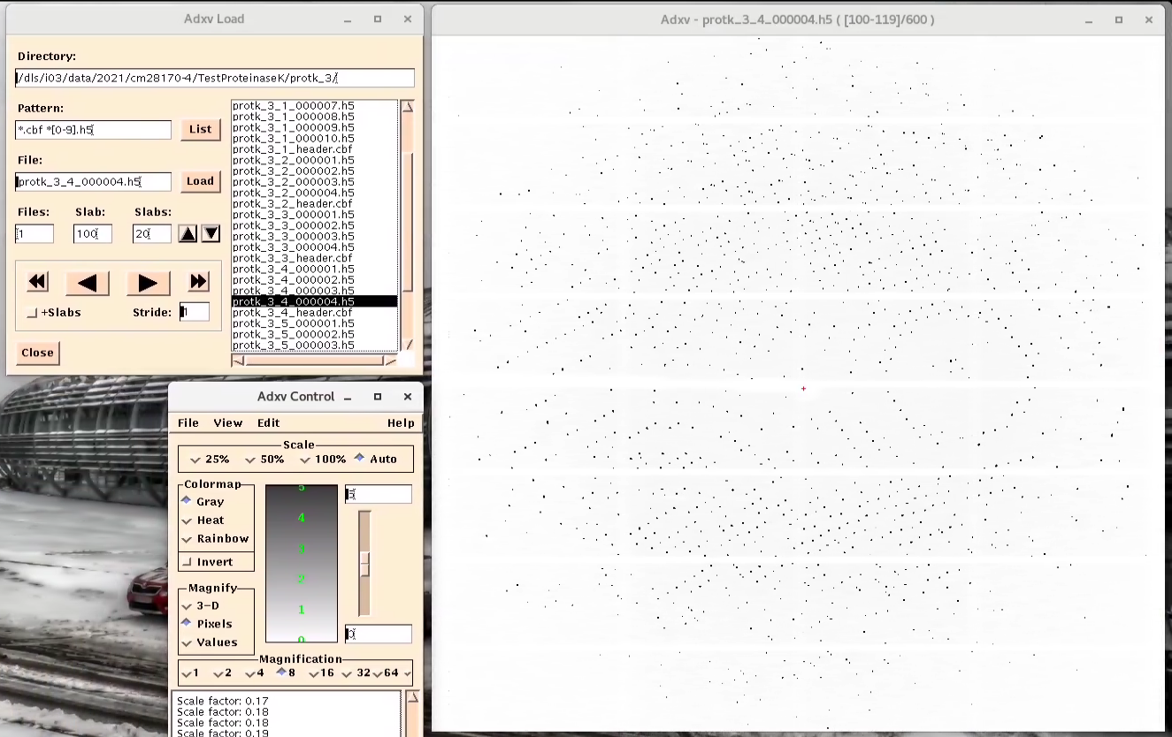

Slide 30
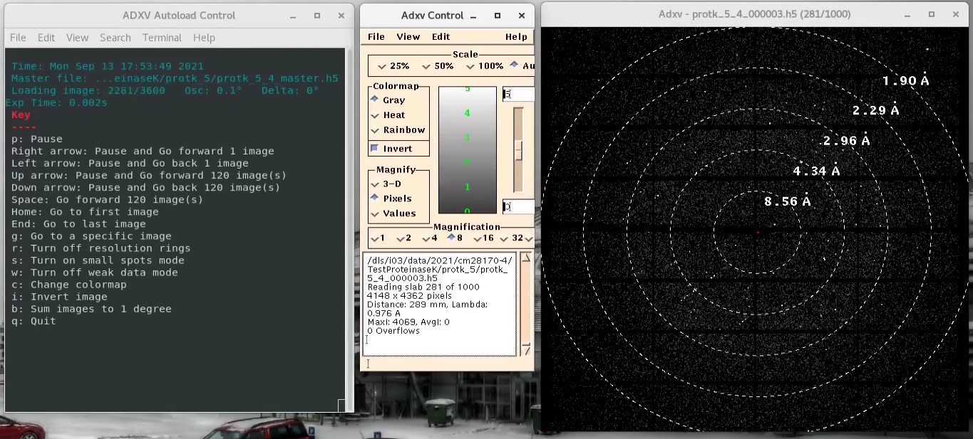
ADXV Autoload

Slide 31
Remote Data Processing
Remember: Work here, not on a beamline workstation

Slide 32
Launch a Terminal
Start a terminal:
Activities → Terminal
Right-click anywhere
→ Open Terminal

Slide 33

Using the Command Line
The Command line is more powerful than a GUI, and there will always be a Command line (not everything is packaged into a GUI)
You can build on basic Command line work with scripts to run tasks more efficiently
BUT get one character wrong and it won’t work…

Slide 34




Slide 35
“Folders” = “Directories”

Slide 36
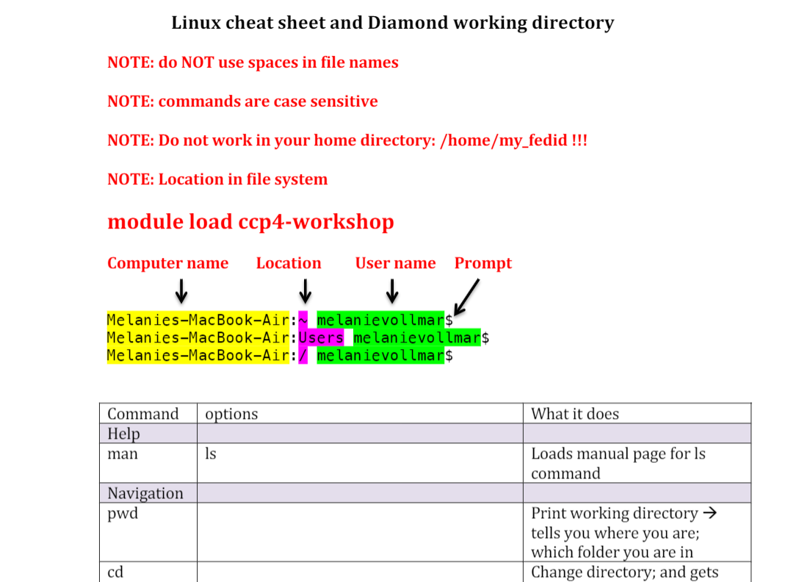
Linux Cheat-Sheet – on Slack
man – gives manual
for command
Grab someone for a tutorial if you need it

Slide 37
Linux - Continued

Slide 38
Linux man
Example man ls
Enter = move down 1 line
Space = move down 1 page
g = move to the top of the page
G = move to the bottom of the page (one of the few times you use a capital)
Q = quit

Slide 39
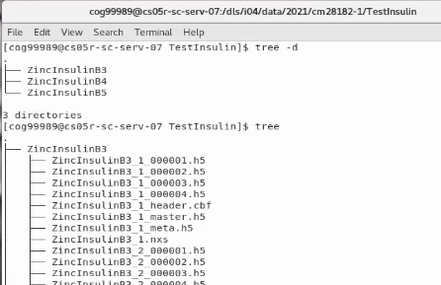
Linux tree
tree –d
tree

Slide 40
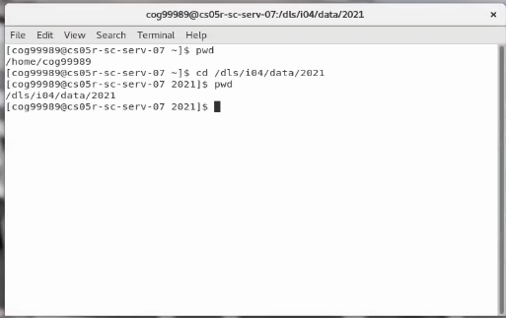
Linux pwd
pwd = Print Working Directory
By default you start in your home directory BUT DON’T WORK IN IT (apart from the basic Linux tutorial)
cd /dls/{beamline}…

Slide 41
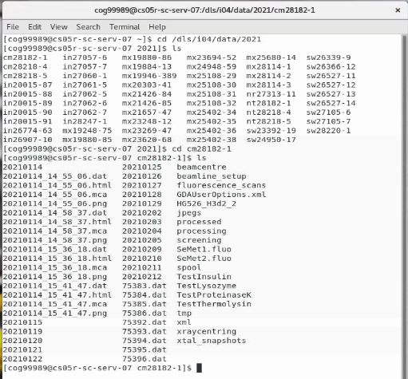
Navigating to data

Slide 42

Deleting files – rm (ReMove)
Proceed with caution
  there is no recycle bin or undo
rm file.img
  Command will delete file.img
You can also inadvertently delete files by over-writing them with a new file with the same name

Slide 43
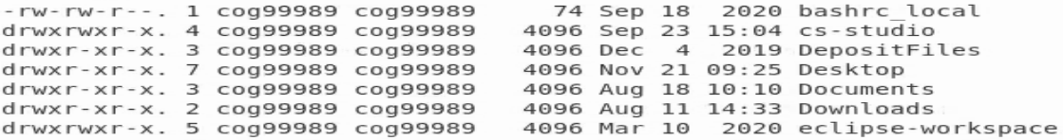
Permissions
ls –l
First character = file (-) or directory (d)
Next 3 characters – permission of the owners
  r = read permission
  w = write permission
  x = execute permission
Characters 5-7 – permission of the group
Characters 8-10 – permission of others

Slide 44
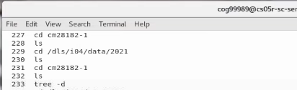
History
history = gives history of most recent commands
  Great if someone has shown you something, and you have forgotten what process they followed to do it!

Slide 45
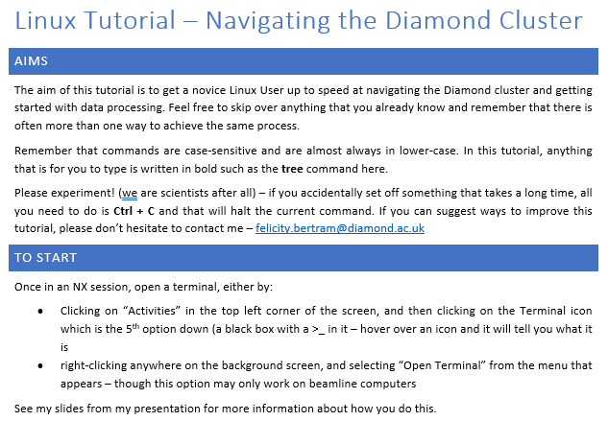

Slide 46
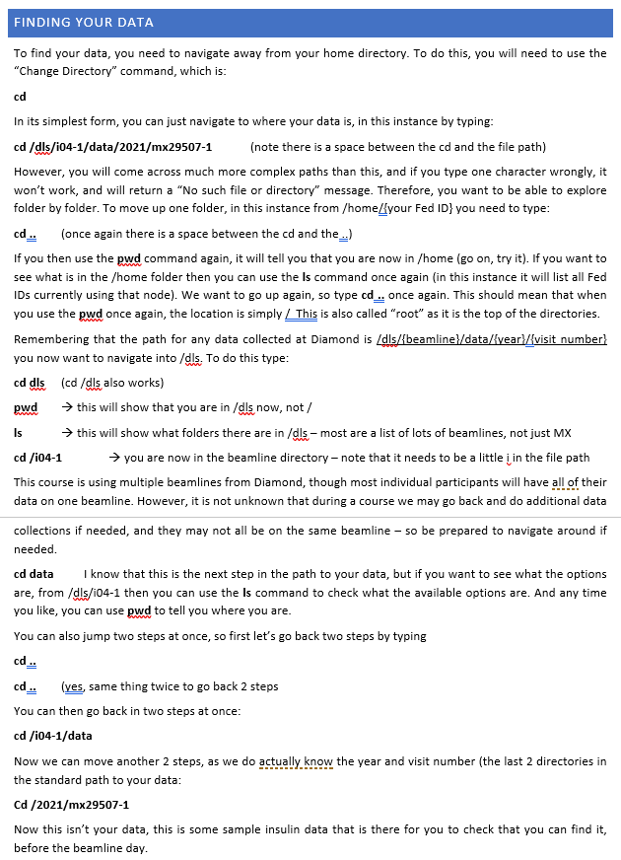

Slide 47
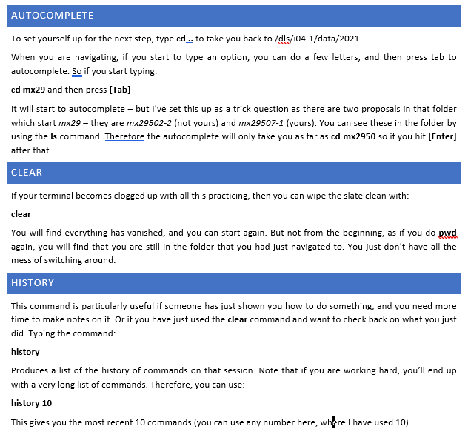

Slide 48
Retrieve your data and take it home
Better to download it within 40 days
Globus – main option, datasets over 20 GB
FTP – File Transfer Protocol, only for datasets under 20 GB
SFTP – Secure File Transfer Protocol, if your institution firewall blocks FTP, only for datasets under 20 GB
rsynch - Good for Unix-like systems like Linux - only recommended for experienced rsync users
https://www.diamond.ac.uk/Users/Experiment-at-Diamond/IT-User-Guide/Not-at-DLS/Retrieve-data.html

Slide 49
Retrieve your data and take it home
After 40 days…
Your data will now be in the archive and need to be restored from tape
Download files using Diamond's TopCAT software
https://www.diamond.ac.uk/Users/Experiment-at-Diamond/IT-User-Guide/Not-at-DLS/Retrieve-data.html

Slide 50

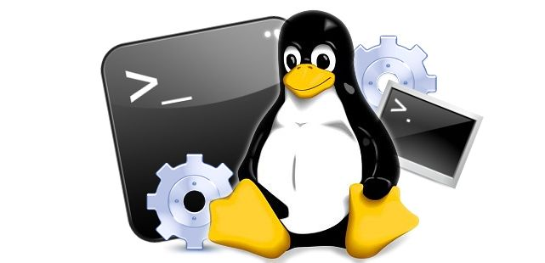
Any questions…?

